Slide 1


Slide 2
Software is an essential component of exotic embedded applications such as airplanes, spaceships, and air traffic control systems, as well as mundane appliances such as watches, ovens, cars, DVD players, garage door openers, mobile phones, and remote controllers.
Software Fault: A static defect in the software.
Software Error: An incorrect internal state that is the manifestation of some fault.
Software Failure: External, incorrect behavior with respect to the requirements or another description of the expected behavior
Notes:
ordinary; not interesting or exciting.
Agile- able to move quickly and easily.
Agile refers to a flexible, iterative approach to software development that prioritizes collaboration, customer feedback, and rapid adaptation to changing requirements, contrasting with rigid, linear methods by delivering working software in small, frequent increments (sprints).

Slide 3
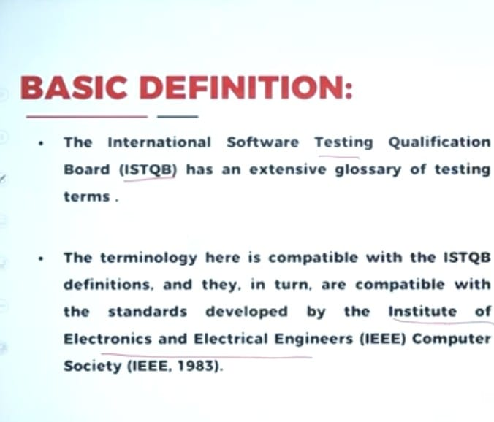
Notes:
Software Testing We use software in our mobile phone, laptop everywhere , you may ask - mam if there is any error/ bug we can debug it then and there or after sometime, what is the great deal in that isn't it.Of course bugs in such systems are definitely negligible but, if there's an error in flight simulator, banking system can I expect the same response from you?1. In the software in the cockpit. So it is important to test the software 2. Also the medical reports are generated by the computer software 3. Hard earned money

Slide 4
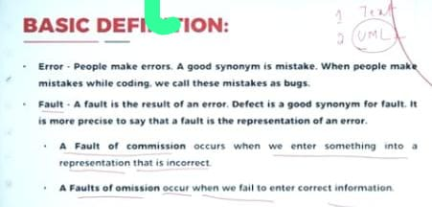
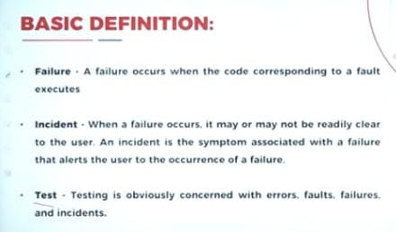
Notes:
Ambiguity- possibility of being misunderstood in more than one way
Error / mistake in the coding/ software is bug The result of that error is fault - denoted by text/ UML- To avoid the problem that we have If I say I have not stolen the silver ring- few might accept but few can start thinking unnecessary things creating ambiguity.UML diagram is used to represent my fault. Entering incorrected entry into the UML is fault of commission Fault of emission: fail to enter

Slide 5
If you have code with fault - then you will encounter failure
Errors- mistakes
Faults- result of mistakes Failure Incident
To identify these 4 things we will do the test
Verification: The process of determining whether the products of a phase of the software development process fulfill the requirements established during the previous phase.
Validation: The process of evaluating software at the end of software development to ensure compliance with intended usage.
Notes:
Incident -.to identify whether I got Covid 19 or not we will consider the symptoms, here also to understand the failure the incidents will alert us, something like symptoms.
Consider a medical doctor diagnosing a patient. list of failures- (that is, symptoms).
discover the fault, or root cause of the symptoms. To aid in the diagnosis, a doctor may order tests that look for anomalous internal conditions, such as high blood pressure, an irregular heartbeat, high levels of blood glucose, or high cholesterol. In our terminology, these anomalous internal conditions correspond to errors

Slide 6
Testing: Evaluating software by observing its execution.
Test Failure: Execution of a test that results in a software failure.
Debugging: The process of finding a fault given a failure.
Notes:
The specifications might say something like, “The lights in front of the projector screen can be controlled independently of the other lights in the room.” If the specifications are written down somewhere and the lights cannot be controlled independently, then the lighting fails verification, precisely because the implementation does not satisfy the specifications. Validation asks whether users are satisfied, an inherently fuzzy question that has nothing to do with verification. If the “independent control” specification is neither written down nor satisfied, then, despite the disappointed users, verification nonetheless succeeds, because the implementation satisfies the specification.

Slide 7
UNIT - I
Introduction:
Basic definitions,
A testing life cycle
Test Cases
Fundamental approaches to apply Test Cases
Levels of Testing: Examples The SATM (Simple Automatic Teller Machine) problem.
Boundary Value Testing:
Generalizing Boundary Value Analysis,
Limitations of Boundary Value Analysis,
Robustness Testing
Worst-Case Testing
Special Value Testing
Test cases for:
The Triangle problem
NextDate function,
The Commission Problem,
Random Testing and Guidelines for Boundary Value Testing.

Slide 8
What is testing?
Definition :
“Software
Testing is the process of executing a program with the intent of finding errors
testing is
a process used to
identify the
correctness, software”
OR
completeness & quality of developed
Reasons for testing
MYTH: Good programmers write code without bugs. (It’s wrong!!!)
History says that even well written programs still have 1-
3 bugs per hundred statements
To discover problems
To make judgment about quality or acceptability
Testing is the process of exercising and evaluating a system or system component by manual or automated means to verify that it satisfies specified requirements.
Primary role of testing is not demonstration of correct performance, but the exposure of hidden defects. - Glen Myers

Slide 9
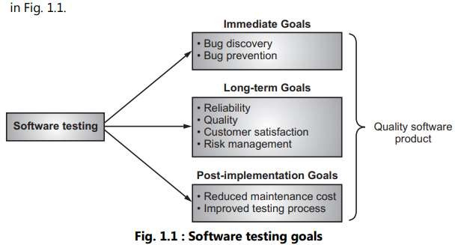
Testing Objectives :
Testing is a process of executing a program with the intention of finding Errors.
Establishing confidence that a program does what it is supposed to do. It is the measurement of Software Quality which confirms that a program performs its intended functions correctly.
Testing identify difference between Expected and Actual Result. This is a process of trying to discover every conceivable fault or weakness in a work product.
Benefits of Software Testing :
Primary benefit of testing is - It improves the Quality as testing looks for a class of problems and flags them as possible candidates for investigation and fixes.
Secondary benefit is - Testing demonstrates that software functions appear to be working according to specifications.
Goals of Software Testing:
The main goal of software testing is to find bugs as early as possible and to fix bugs and to make sure that the software is bug free.
The goals of software testing may be classified in to three
major categories as shown in Fig. 1.1.

Slide 10
1. Immediate Goals: These goals are also called as short term goals.
iii. Reliability: It is a matter of confidence that the
software will not fail. In short reliability means to gain the confidence of the customers by providing them a quality product.
iv. Risk management: Risk must be done to reduce the failure of product and to manage risk in different situations.
These testing goals are the immediate result after
testing. These goals contain:
Bug discovery: Is the immediate goal of software testing to find errors at any stage of software development. Number of the bugs are discovered in early stage of testing.
Bug prevention: Is the consequent action of bug
discovery.
2. Long Term Goals: These testing goals affect the
3. Post Implemented Goals: These goals are important after the software product released.
Some of them are listed below:
i. Reduce maintenance cost: Post-released errors are costlier to fix and difficult to identify.
software product quality in the long term. These include:
(i) Quality: This goal enhances quality of the software product.
ii. Improved software testing process: These goals
improve the testing process for future use of software
(ii) Customer
customers product.
satisfaction:
satisfaction
This goal verifies the for developed software
projects. These goals are known as
postimplementation goals.

Slide 11
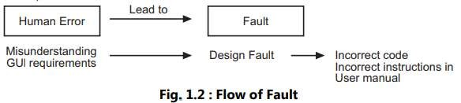
NATURE OF ERRORS :
Errors
Faults
Failures
Defects
Errors : An error
Calculation errors.
Errors in handling or interpreting data.
Documentation - The user does not observe operation described in manuals.
Testing errors.
Faults:
is a mistake, misconception or
misunderstanding on the part of a software developer.
A fault occurs when a human error results in a mistake in some software product(s).
For example, a developer might misunderstand a user- interface requirement and therefore create a design that includes misunderstanding.
The design fault can also result in incorrect code, as well as incorrect instructions in user manual.
It might be typographical error, a misleading of specifications, a misunderstanding of what a subroutine does.
The errors may be :
Actual bugs in the code.
Incorrect implementation of the requirements or
functional specifications because of Misunderstandings and/or Incomplete requirements or functional specifications

Slide 12
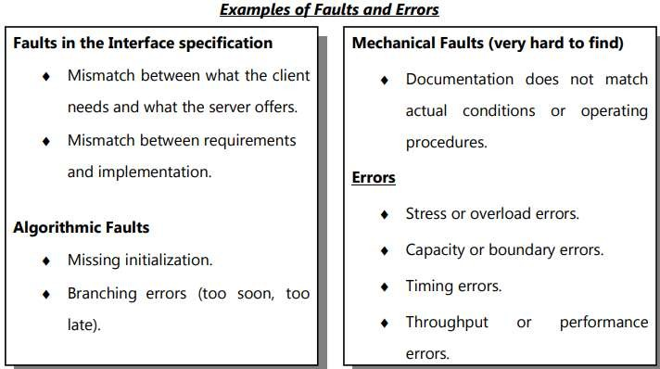
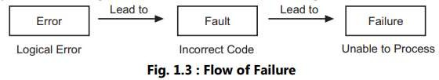
SS
Failure:
Failures can be defined as :
A system failure occurs when the system fails to perform its required function
Failures can be discovered both before and after system delivery, as they can occur in testing as well as in operation.
Faults represent problems that the developer sees, while failures are problems that the user sees.
Note: A fault (bug) can go undetected until a failure occurs, which is when a user or tester perceives that the system is not delivering the expected service.

Slide 13
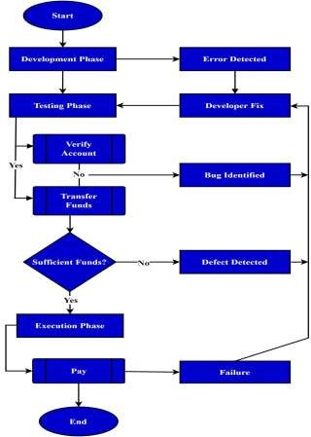
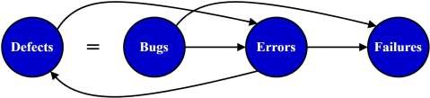
All these terms are related to each other:
fd
We can see that defects (i.e., bugs) and errors can lead to failures, and errors can contribute to defects in the software development and testing process.
Example: Online Banking Application
Let’s consider an online banking application designed for various banking transactions, such as checking account balances, transferring funds, and paying bills.
During various phases of software development, the team examines the application’s functionalities to ensure it meets the desired requirements:

Slide 14
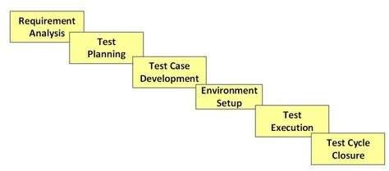
In one scenario, a tester attempts to transfer funds from
Software Testing Life Cycle (STLC)?
one account to another using an online banking
application.
However, the application allows the transfer to proceed even if the sender’s account has insufficient funds.
This means that there is a defect in the system.
We find a bug in the application that allows transfers without verifying the sender’s account balance.
After identifying the issue, we report it and log it as a
bug.
Our analysis indicates that the root cause of this bug is the absence of confirmation for the sender’s account balance.
Then, a developer analyzes the code responsible for fund transfers during the code review.
The developer identifies an error where an incorrect variable is used for account balance validation.
This error could potentially lead to further issues if left unresolved.
Software Testing Life Cycle (STLC) is a sequence of specific activities conducted during the testing process to ensure software quality goals are met.
STLC involves both verification and validation activities.
STLC Phases
There are following six major phases in every Software Testing Life Cycle Model (STLC Model):
Notes:
Development Phase
1️⃣ Creating Test Cases
Testers write test cases for each functionality of the application.
A test case includes:
Test Case ID
Test Steps
Test Data
Expected Result
Feature: Login functionality
Test Case:
Test Case ID: TC_Login_01
Steps:
Open login page
Enter valid username
Enter valid password
Click Login
Expected Result: User should be logged in successfully
Manual test case: Verify login
Automation script: Script that automatically enters username/password and checks login success
✅ Automation saves time during regression testing.

Slide 15
Test Scenario-high level understanding of any application functionality- Test cases-detailed explanation of any particular test scenario: Eg: You have Flipkart application- test scenario will say that login functionality should follow step by step process ie what needs to be done. Test Cases tell -how to test it. It has brief description of how to test it. 1. open browser 2. Enter User id 3. password Drawbacks of not writing test cases- 1. no consistency in test case execution. 300 test cases: application is working fine and published 2nd release: 203 test cases 3rd release: 150 test cases 2. Not covered all scenarios 3. Developers mood 4. Memory of the test engineer 5. Quality of the testing varies from person to person 6. based on customer requirement- test cases have to be updated
.

Slide 16
Step by step /standard procedure to test any software-STLC
Defect Tracking(D/T)
SDLC--> STLC--> D/T;
various stages in STLC- Requirement condition- System study (of the requirement-developer/technical team)-
Test plan(how who when)-
Write test cases(system study-individual test engineers-module wise)-
Identify Possible Scenario(IPS)- Write test cases- Review- Fix review commands-approval-repository (store).
Once test case part is done- prepare Traceability Matrix(RTM)-document which ensures each document has got at least one test cases.

Slide 17
Stages in STLC:
Traceability Matrix-RTM/CRM- document which ensures each and every requirement has got atleast one test cases in it.
Each requirement should have on test cases
Forward TM/Horizontal TM- Each requirement has one test case or not(prepared while planning before test case execution)
Backward TM/Vertical- Map test cases for the requirement is ensured. Once after test execution is done
Bi-directional TM-combination of forward and backward TM
Defect Tracking(DT)
TCER(Test Case Execution Report)-prepared by test lead-
RM-Retrospective Meeting
Notes:
Cross reference matrix
Bug,who when

Slide 18
Requirement Phase Testing
Test Planning in STLC
Test Planning in STLC is a phase in which a Senior QA manager determines the test plan strategy along with efforts and cost estimates for the project.
Moreover, the resources, test environment, test limitations
and the testing schedule are also determined.
The Test Plan gets prepared and finalized in the same phase.
Test Planning Activities
Preparation of test plan/strategy document for various types of testing
Test tool selection
Test effort estimation
Resource planning and determining roles and responsibilities.
Training requirement
Test plan/strategy document.
Effort estimation document.
Requirement Phase Testing also known as Requirement Analysis in which test team studies the requirements from a testing point of view to identify testable requirements and the QA team may interact with various stakeholders to understand requirements in detail.
Activities in Requirement Phase Testing
Identify types of tests to be performed.
Gather details about testing priorities and focus.
Prepare Requirement Traceability Matrix (RTM).
Identify test environment details where supposed to be carried out.
Automation feasibility analysis (if required).
Deliverables of Requirement Phase Testing
RTM
Automation feasibility report. (if applicable)
testing is
Deliverables of Test Planning

Slide 19
Test Case Development Phase
Test Environment Setup
Test Environment Setup decides the software and
The Test Case Development Phase involves the creation, verification and rework of test cases & test scripts after the test plan is ready.
Initially, the Test data is identified then created and reviewed and then reworked based on the preconditions.
Then the QA team starts the development process of test cases for individual units.
hardware conditions under which a work product is tested.
It is one of the critical aspects of the testing process and can be done in parallel with the Test Case Development Phase.
Test team may not be involved in this activity if the development team provides the test environment.
The test team is required to do a readiness check (smoke
testing) of the given environment.
Test Case Development Activities
Create test cases, automation scripts (if applicable)
Review and baseline test cases and scripts
Create test data (If Test Environment is available) Deliverables of Test Case Development
Test cases/scripts
Test data
Notes:
The Test Case Development Phase comes after Test Planning in the Software Testing Life Cycle (STLC).

Slide 20
Test Environment Setup Activities
Test Execution Phase
Test Execution Phase is carried out by the testers in which testing of the software build is done based on test plans and test cases prepared.
Understand the required architecture, environment set-up and prepare hardware and software requirement list for the Test Environment.
Test Environment Setup Activities
Understand the required architecture, environment set-up and prepare hardware and software requirement list for the Test Environment.
Setup test Environment and test data
Perform smoke test on the build
Deliverables of Test Environment Setup
Environment ready with test data set up
Smoke Test Results.
The process consists of test script execution, test script
maintenance and bug reporting.
If bugs are reported then it is reverted back to development team for correction and retesting will be performed.
Execute tests as per plan
Document test results, and log defects for failed cases
Map defects to test cases in RTM
Retest the Defect fixes
Deliverables of Test Execution
Completed RTM with the execution status
Test cases updated with results
Defect reports
Test Execution Activities

Slide 21
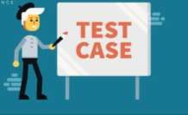
“A test case is a set of actions that verify whether the software application is Working as per the client’s requirements”.
Test Case:
Typical Test Case Parameters
Let’s talk about the test case parameters in detail,
Test Case ID
It is a unique identifier for the test case. It is usually represented using alphanumeric or numeric characters.
Test Scenario
It is a brief description of what needs to be performed by
the testers.
Test Case Description
It is a detailed explanation of what function has to be tested.
Test Steps
Test steps are a sequence of steps or actions to be executed to check a particular functionality or condition.
Prerequisite
Prerequisites are conditions that are required to perform the test. Typically, testers must check or fulfill the prerequisites before starting the test process.
It involves specifying the input values to use, the expected outcomes and the steps to be taken to determine whether the application is behaving correctly under various conditions.
Test cases are a critical component of software testing and are usually created by software testers during the testing phase.
TC include parameters such as test case ID, test data, description, test steps, expected result, actual result, status, and comments.
These parameters help testers keep track of the various test cases and the results of each test, ensuring that any issues or bugs in the software are identified and resolved before it is released to the end-users.

Slide 22
.
Test Case Document
Quality Test Cases:
Cover all possible test cases
Steps should be min and understandable
Test case document should be clear
POSITIVE NEGATIVE CASES- focus
Capability to catch the defects
NO duplicate test cases
.

Slide 23
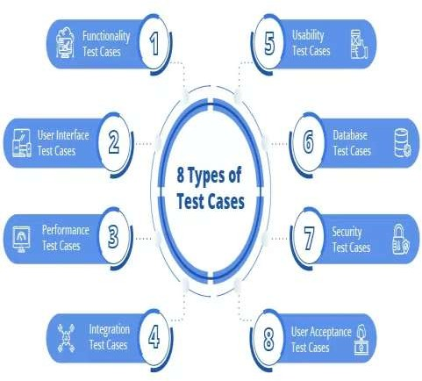
Types of Test Cases
Test Data
Test data refers to the input data or values required to execute the test case. For example, username and password are the test data to test the email login.
Expected Result
It refers to the expected behavior or output that should be observed when executing the test case.
Test Parameters
Parameters that are assigned to a specific test case.
Actual Result
It is the actual output or behavior observed during the test case
execution.
Status
It shows the status of tests, like pass, fail, or NA.
Comments
It includes remarks on how developers can improve the software quality.

Slide 24
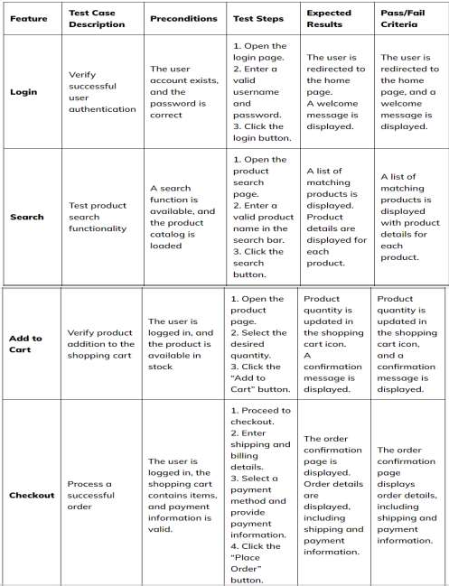
Functional test cases: are an essential part of the software testing process.
They provide a clear and detailed set of instructions for testing specific functions in an application.
By outlining the input conditions, expected outcomes,
and steps for executing the test, functional test cases
Ex:
help testers and developers understand process and results.
What should a Functional Test Case have?
the testing
A functional test case should clearly define what is being tested:
the steps to execute the test,
the expected results, and
the preconditions that must be met before the test can be run.
Examples of Functional Test Cases
Here is a table format to better understand:

Slide 25
UI Test Cases:
UI test cases are the list of tests that focus on verifying the functionality and behavior of a software application’s user interface.
Document UI Elements: Clearly identify elements to interact with.
Test Data and Environment: Specify test data and the testing environment.
Sequence and Flow: Ensure logical sequence for user workflows.
Assertions: Define verifications to match expected and actual UI
elements.
Negative Scenarios: Include error-triggering tests for validation.
Screenshots: Attach images to clarify the expected UI appearance.
Review and Validation: Ensure accuracy, clarity, and completeness.
Data Preparation: Provision required test data and configurations.
Automation Consideration: Identify opportunities for UI test automation.
Documentation: Maintain organized test case documentation.
Execution Plan: Plan test execution in the designated environment.
Execution and Reporting: Execute, record results, and report defects.
These test
elements,
cases ensure that the application’s graphical
such as buttons, menus, forms, and visual
components, work as expected and provide a positive user experience.
GUI test cases include functional UI testing, layout and design testing, navigation testing, input validation and error-handling testing.
UI Test Case Examples
Understand Requirements: Familiarize yourself with design and functional requirements.
Identify Test Scenarios: List scenarios, user interactions, and workflows.
Prioritize Test Cases: Rank cases based on criticality and usage.
Create Test Cases: Craft clear test cases with titles, steps, data, and expected
outcomes.
Include Data: Specify input values, credentials, and expected data.
Notes:
Username text box should be properly aligned below the username label.
Characters should be hidden
Login button should be visible, enabled, and clickable.
Mandatory fields should be marked with * (asterisk).
Error messages should be displayed in red color.
Submit button should be aligned properly at the bottom center.
Button label should be clearly readable and correctly spelled.
User should be navigated to the Forgot Password page.
User should return to the previous page without errors.

Slide 26
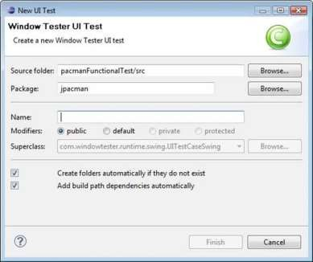
How to do GUI Test
Test case 03 – Verify that label with the name “Browse” is a button which is located at the end of TextBox with the name “Source Folder.”
Test case 04 – Verify that label with the name “Browse” is a button which is located at the end of TextBox with the name “Package.”
Test case 05 – Verify that the text box with the label “Name” is aligned properly.
Test case 06 – Verify that the label “Modifiers” consists of 4 radio buttons with the name public, default, private, protected.
Test case 07 – Verify that user must not be able to type in the
dropdown of “Superclass.”
Test case 08 – Verify that there must be a proper error generated if something has been mistakenly chosen.
Test case 09 – Verify that the error must be generated in the RED color wherever it is necessary.
Test case 10 – Verify that proper labels must be used in the error messages.
Following below is the example of the Test cases, which consists of UI and Usability test scenarios.
Test case 01- Verify that the text box with the label “Source
Folder” is aligned properly.
Test case 02 – Verify that the text box with the label “Package” is aligned properly.
Test case 11 – Verify that the single radio buttons must be selected by default every time.

Slide 27
Performance Test case:
Performance Testing is a software testing process used for
Example Performance Test Cases
Test Case 01: Verify response time is not more than 4 secs when 1000 users access the website simultaneously.
Test Case 02: Verify response time of the Application Under Load is within an acceptable range when the network connectivity is slow
Test Case 03: Check the maximum number of users that the application can handle before it crashes.
Test Case 04: Check database execution time when 500 records are read/written simultaneously.
testing the speed, response scalability, and resource usage under a particular workload.
time, of a
stability, software
reliability, application
The main purpose of performance testing is to identify and eliminate the performance bottlenecks in the software application.
The focus of Performance Testing is checking a
software program’s
Speed – Determines whether the application responds quickly
Scalability – Determines the maximum user load the software application can handle.
Stability – Determines if the application is stable under varying loads
Test Case 05: Check CPU and memory usage of the application and the database server under peak load conditions
Test Case 06: Verify the response time of the application under low, normal, moderate, and heavy load conditions.
Refer link for tools:
https://www.qatouch.com/blog/top-6-mobile-testing-tools/

Slide 28
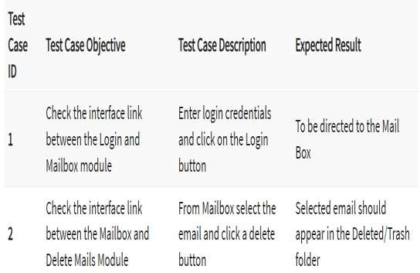
What is Integration Testing?
EX:
Integration Testing is defined as a type of testing where software modules are integrated logically and tested as a group.
A typical software project consists of multiple software
modules, coded by different programmers.
The purpose of this level of testing is to expose defects in the interaction between these software modules when they are integrated
Example of Integration Test Case
Integration Test Case differs from other test cases in the sense it focuses mainly on the interfaces & flow of data/information between the modules. Here priority is to be given for the integrating links rather than the unit functions which are already tested.
Sample Integration Test Cases for the following scenario: Application has 3 modules say ‘Login Page’, ‘Mailbox’ and ‘Delete emails’ and each of them is integrated logically.
Here do not concentrate much on the Login Page testing as it’s already been done in Unit Testing. But check how it’s linked to the Mail Box Page.
Similarly Mail Box: Check its integration to the Delete Mails Module.
Notes:
Integration Testing is a level of software testing where individual software modules are combined and tested as a group to check data flow, interfaces, and interactions between them.
Data passed between modules ✅ Control flow between modules ✅ Interface compatibility ✅ Order of execution
est Case: Enter valid username and password
Expected Result: User should be navigated from Login Page to Mailbox page
✅ Focus: Connection between Login and Mailbox
Mailbox → Delete Mail
Test Case: Select an email and click Delete
Expected Result: Selected email should be removed from Mailbox
✅ Focus: Interaction between Mailbox and Delete module
We do NOT test login functionality again, because it was already tested in Unit Testing
ntegration Test Case:
User logs in
Selects a product
Proceeds to payment
Expected Result: User details and product details should be correctly passed to the payment module.

Slide 29
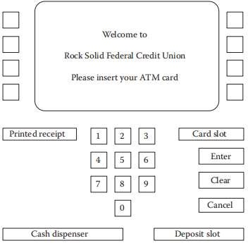
The SATM System Problem statement
The SATM System
The SATM(Simplified Automated Teller Machine) system communicates with bank customers via the 15 screens.
Customers can select any of three transaction types
Deposits
Withdrawals
Balance enquires
Transactions can be done on two types of account
checking
savings

Slide 30
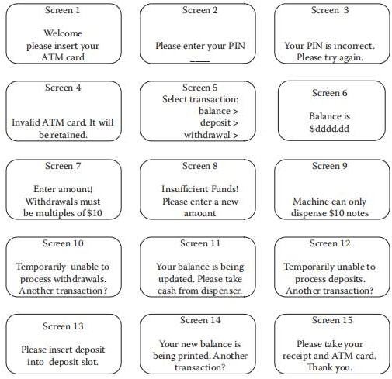
1. Problem Statement
If the customer’s PAN is not found, screen 4 is displayed, and the card is kept.
The SATM system communicates with bank customers via the 15 screens shown in Figure 2.
Using a terminal with features as shown in Figure 1, SATM customers can select any of three
At screen 2, the customer is prompted to enter his or her
personal identification number (PIN).
If the PIN is correct (i.e., matches the information in the customer account file), the system displays screen 5; otherwise, screen 3 is displayed.
transaction types:
Deposits
withdrawals, and
balance inquiries.
For simplicity, these transactions can only be done on a checking account.
When a bank customer arrives at an SATM station, screen 1 is displayed.
The bank customer accesses the SATM system with a plastic card encoded with a personal account number (PAN),
which is a key to an internal customer account file, containing, among other things, the customer’s name and account information.
If the customer’s PAN matches the information in the customer account file, the system presents screen 2 to the customer.

Slide 31
Boundary Value Testing
testing of data is done based on boundary values or between two opposite ends where the ends may be like from start to end, or lower to upper or from maximum to minimum.
From the above table, we can view the following inputs that are given.
The minimum boundary value is given as 21.
The maximum boundary value is given as 65.
The valid inputs for testing purposes are 21, 22, 64 and 65.
The invalid inputs for test cases are 20 and 66.
This testing process was introduced to select boundary values that came from the boundary based on the inputs at different ends of testing values.
This testing process is actually known as black-box testing that focuses on valid and invalid test case scenarios and helps in finding the boundary values at the extreme ends without obstructing any effective test data.
Test Case Scenarios
1. Input: Enter the value of age as 20 (21-1)
Test Case of Boundary Value Testing
Test Case 1:
Output: Invalid
Let us assume a test case that takes the value of age from 21 to 65.
BOUNDARY VALUE TEST CASE
INVALID TEST CASE (Min Value – 1) | VALID TEST CASES (Min, +Min, Max, -Max) | INVALID TEST CASE (Max Value + 1)
20 | 21, 22, 65, 64 | 66
2. Input: Enter the value of age as 21
Output: Valid
Assignment Q1: explain drawbacks of boundary value analysis
Notes:
Boundary Value Testing (BVT)
Boundary Value Testing is a black‑box test design technique in which test cases are designed using the boundary values (edge values) of the input domain.

Slide 32
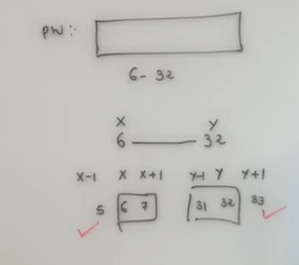
Easiest Test Design Technique-
2 ranges are given-Min value and Max value are given:
Lets assume password field -End user can enter min 6-max 30 characters.
Lets assume x and y .
Front end side-client side we have to test x-1.x.x+1 at min side: y-1,y,y+1 at max side. It should accept 31,32 and 6,7.

Slide 33
Drawbacks of Boundary Value Analysis (BVA) Boundary Value Analysis is a useful test design technique, but it has some limitations. Drawbacks: Only boundary values are tested It does not test the values in the middle of the input range, where defects may also exist. Not suitable for complex logic BVA works well only when input ranges are clearly defined. It is not effective for complex calculations or business rules. Ignores internal structure Since BVA is a black‑box technique, internal program logic is not tested. Does not test combinations of inputs It focuses on one variable at a time and ignores interaction between multiple input variables. May miss logical errors If a defect is not related to boundary values, BVA will not detect it.
Notes:
Open notepad-type-click on save-as welcome.java-D drive-go to the particular path(folder)-

Slide 34
Write Test Cases for DATE Function Inputs: Day (DD), Month (MM), Year (YYYY) Output: Valid Date / Invalid Date
Positive Test Cases
Test Case | Input | Expected Result
TC01 | 01‑01‑2024 | Valid date
TC02 | 31‑12‑2025 | Valid date
TC03 | 29‑02‑2024 | Valid (Leap year)
TC04 | 30‑06‑2023 | Valid date
Test Case | Input | Expected Result
TC05 | 31‑04‑2023 | Invalid (April has 30 days)
TC06 | 29‑02‑2023 | Invalid (Not leap year)
TC07 | 32‑01‑2024 | Invalid (Day out of range)
TC08 | 15‑13‑2024 | Invalid (Month out of range)

Slide 35
Write Performance Test Cases for a Mobile Application Performance Test Case Examples
Test Case | Description | Expected Result
PT01 | Check app launch time | App opens within 3 seconds
PT02 | 1000 users login simultaneously | No crash, acceptable response
PT03 | App usage with low internet speed | App works without freezing
PT04 | Check battery consumption | No abnormal battery drain
PT05 | App response under high load | Stable performance

Slide 36
The triangle problem :
The input to the TriangleType function are three numbers a, b and c that represent the lengths of the three sides of the triangle.
Based on these inputs the function determines the type of the
triangle, which can be
–Equilateral (i.e. all three sides are equal)
–Isosceles (two equal sides)
–Scalene (three unequal sides)
The function returns the result in the form of the character
string,
e.g. ‘Equilateral’ if the triangle is equilateral.
basically, we will validate the different requirements which are nothing but the different properties of a triangle.
1. Verify that the figure is closed (polygon).
4. Verify that the figure has exactly three vertices.
5. Verify that the figure has exactly three angles.
6. Verify that the sum of the angles of the figure is 180 degrees.
7. Verify that no two sides are parallel to each other.
8. Verify that the sum of the length of two sides of the triangle should be greater than the length of the third side.
9. Verify that no two angles of a triangle have 90 degrees and
above value.
10.Verify the type of triangle is as per the specification, based on its sides – scalene, isosceles or equilateral.
11.Verify the type of triangle is as per the specification, based on its angles – acute angle, obtuse angle, or right-angled triangle.
Verify that the figure is two-dimensional and formed with straight lines only.
Verify that the figure has exactly three sides.
12.Verify that the area of a triangle is equal to half of the product of its base and height.

Slide 37
Negative Test Cases For triangle
Assignment Questions:
explain drawbacks of boundary value analysis
Write test case for DATE function
Write note on robustness testing, worst case testing, special
value testing.
Write performance test case for mobile application.
Explain Random testing with example
Submit on 5/02/2026 without fail
1. Verify that the sum of any two sides is not greater than the third side (violation of triangle inequality theorem)
2. Verify that if there is not all three sides are provided
3. Verify that if any of the three sides is not a finite number (e.g. NaN,
infinity)
4. Verify that any of the three sides is too large or too small to be a realistic side length of a triangle in the real world.

